Slide 1
The flux of antihelium nuclei from a globular cluster of antimatter in the Galaxy
M. Khlopov, A. Kirichenko, A. Kravtsova, А. Mayorov
XXIV Bled Workshop "What comes beyond the Standard models?"

Slide 2
At present, the AMS-02 experiment to study the characteristics of cosmic rays has been launched at the International Space Station.
The registrationof antihelium would indicate the existence of an additional source of antimatter.
We propose a method for calculating the flux of antihelium nuclei from GC. For this, the trajectory of antinuclei is simulated in the magnetic fields of the Galaxy and in interstellar matter.
The data obtained will be used to interpret the results of experimental searches for antinuclei in cosmic rays and to study the mechanism of the origin of the baryon asymmetry of the Universe.

Slide 3
Introduction
Possible nature of antimatter in the universe:
1.Primordial antimatter.
2. Secondary antimatter(from nucleosynthesis by cosmic rays).
3.Antimatter from exotic sources.

Slide 4
Primordial antimatter(1)
The baryonic asymmetry of the Universe - is the observed predominance of matter over antimatter in the visible part of the Universe. A. D. Sakharov and V.A. Kuzmin formulated the necessary conditions for baryosynthesis: 1. Asymmetry between particles and antiparticles as a violation of charge C- and combined CP-symmetry. 2. Violation of the law of conservation of baryon charge. 3. Violation of local thermodynamic equilibrium.

Slide 5
Primordial antimatter(2)
In the Universe, not only regions with an excess of matter can be formed, but also regions with an excess of antimatter can be formed too in the case of inhomogeneous baryosynthesis. Globular clusters of antistars could form during the formation of the Galaxy and remain in its halo by now. Cosmic ray fluxes of antinuclei are the profound signature of antimatter stars and provide the probe of their existence.

Slide 6
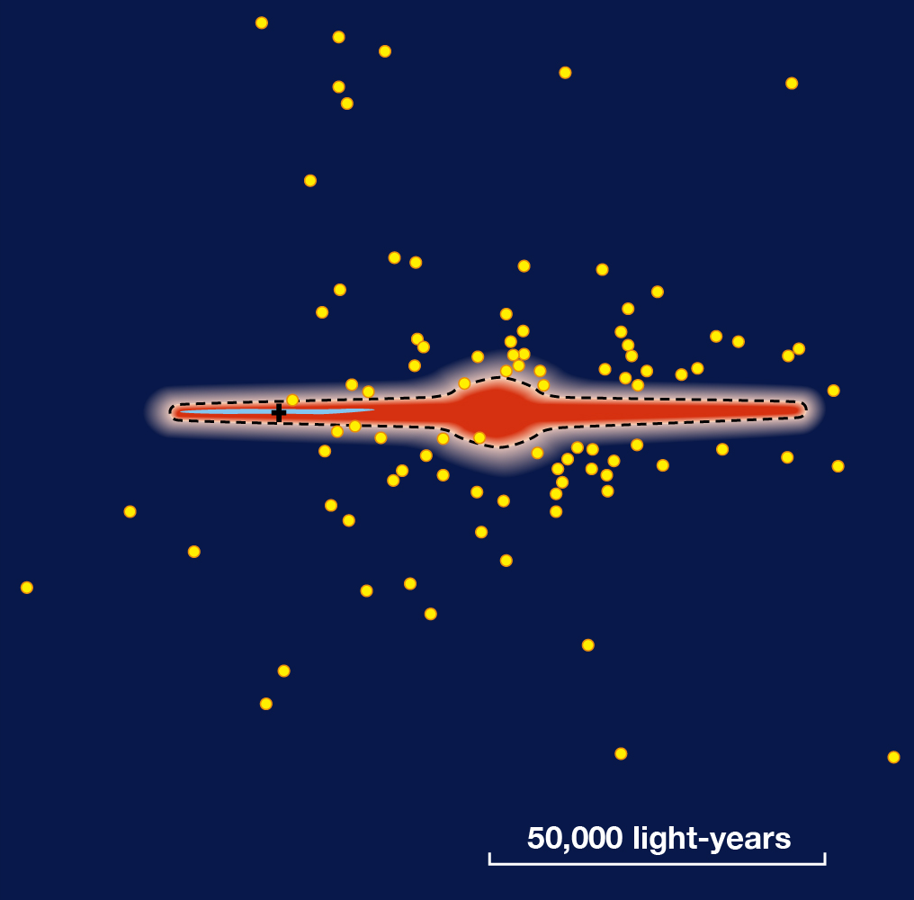
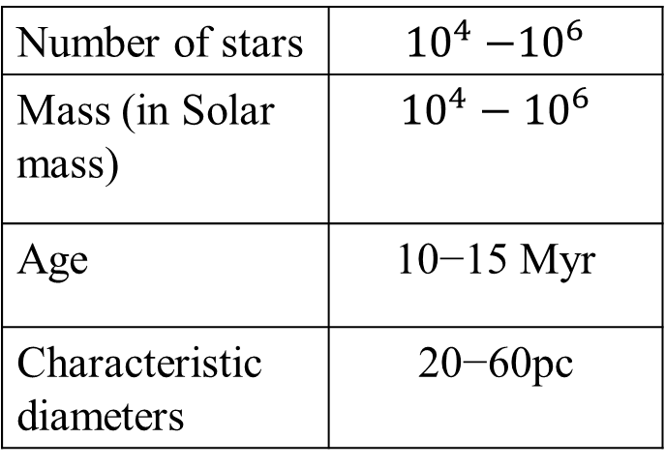
Globular clusters
A globular star cluster is a group of stars which forms a cluster of a spherical shape, rotated around the center of the galaxy.
Number of stars | $${10}^{4}{−10}^{6}$$
Mass (in Solar mass) | $${10}^{4}−{10}^{6}$$
Age | 10−15 Myr
Characteristic diameters | 20−60pc
Illustration of our galaxy with detected globular clusters distributed around the center, the position of the Sun is indicated by a cross
According to the catalog of galactic globular clusters http://gclusters.altervista.org/

Slide 7
Formulation of the problem
The work considers a typical globular cluster, presumably consisting of antistars and use as prototype the M4 cluster [1].
Three possible injection mechanisms: 1. The stationary flow of matter from the surface of antistars 2. Flare antistars 3. AntiSupernova Explosions
[1] Douglas C. Heggie, Monte Carlo simulations of star clusters – V. The globular cluster M4 (2008).
age | distance from the Sun | number of stars
12 billion years | 1.72 kpc | 8 ∙ ${10}^{4}$

Slide 8
Magnetic field of the Galaxy(1)
Where R0 = 5 kpc and z0 = 0.5pc are scale lengths, and parameter B1 is free in this article and is determined by calibration, for example, by a magnetic field near the solar system according to [7].
[6] C. J. Nixon, T. O. Hands The origin of the structure of large–scale magnetic fields in disc galaxies (2018)
[7] M. Opher, F. Alouani Bibi A strong, highly-tilted interstellar magnetic field near the Solar System

Slide 9
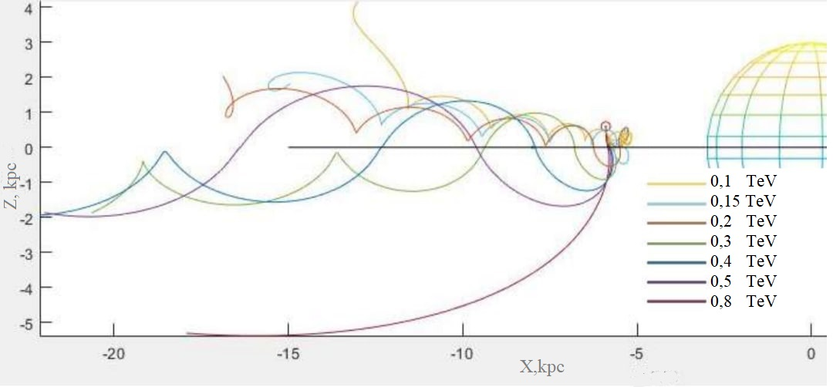
Magnetic field of the Galaxy(2)
Сut off energy ~ 100 GeV

Slide 10
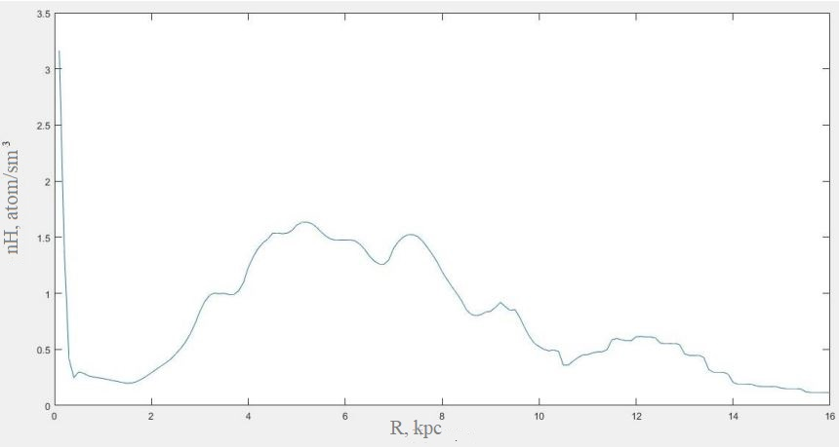
Interstellar medium
The total concentration of interstellar gas(hydrogen)

Slide 11
Conclusion
In this work, we considered the typical globular cluster M4 as a prototype of a source of antinuclei in cosmic rays.
We calculated the energy density of high energy antiparticles ejected by antimatter GC. It is required to clarify the obtained result.
Thus further work is aimed at modeling the motion of particles in the magnetic field of the Galaxy, in order to estimate the cut off that a particle penetrating into a galactic disk should have.
Implementation of our program will help to obtain predictions of the expected flux of antinuclei as the signature of antimatter stars in our Galaxy.

Slide 12
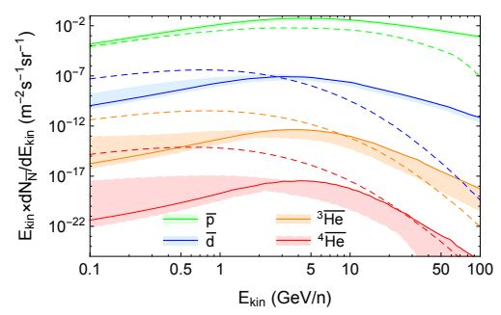
Secondary antimatter
Secondary antimatter in the galaxy is formed as a result of the collision of the high-energy nuclear component of cosmic rays with interstellar gas. Studying the processes of birth of antinuclei on accelerators made it possible to determine the cross section of these processes. Figure [2] shows the calculated spectrum for secondary antiparticles
[2] Ilias Cholis, Tim Linden, Dan Hooper Anti-Deuterons and Anti-Helium Nuclei from Annihilating Dark Matter (2020)

